Slide 1

Practical Test Techniques for
More Effective Testing
Bj Rollison
Test Architect
Engineering Excellence Group
Microsoft, Inc.
willro@microsoft.com
http://blogs.msdn.com/imtesty

Slide 2
Objectives
Use functional techniques to reduce redundancy
  Equivalence class partitioning
  Boundary value analysis
  Combinatorial analysis
Use structural techniques to improve coverage
  Decision coverage
  Condition coverage
  Basis path coverage

Slide 3
What is software testing?
Any activity designed to evaluate the attributes and capabilities of a program’s ability to satisfy any applicable standards or requirements
The primary objectives of testing include:
  Evaluate ‘quality’
  Provide information
Quality is the totality of features and characteristics of a product or service that bear on its ability to satisfy specified or implied needs.

Slide 4
Testing is the ultimate challenge!
Define an extremely small subset of tests
Provide a high degree of confidence
Adequately assess critical quality attributes
Identify potential areas of risk
Do all the above within a limited time
“There are more tests in a program with 70 branches than teaspoons of water in the Pacific Ocean.” – G. Myers, The Art of Software Testing

Slide 5
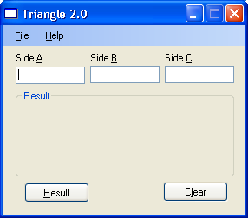
Warm-up: Weinberg’s Triangle
A program reads three (3) integer values. The three values are interpreted as representing the lengths of the sides of a triangle. The program displays a message that states whether the triangle is scalene, isosceles, or equilateral.

Slide 6
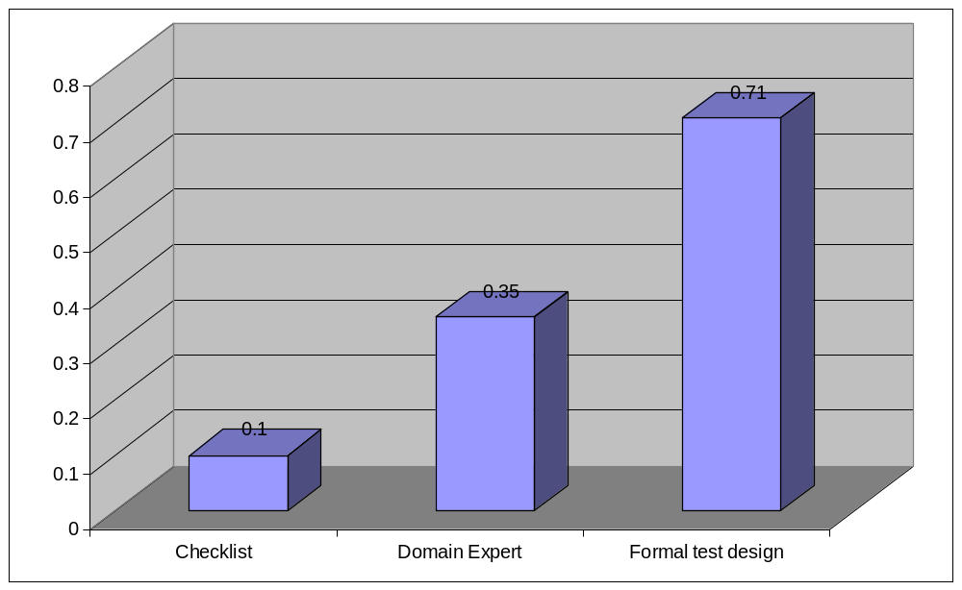
Why are techniques important?
SQS case study – defects/test case
Techniques are systematic procedures by which complex tasks are accomplished; skills and procedures with which an operation or experiment is carried out

Slide 7


Functional techniques
Typically regarded as black box techniques, but can also be used for white box test design
Evaluate operational capabilities of software
Used to establish solid foundation
High probability of early defect detection*
Techniques include:
  Equivalence class partitioning
  Boundary value analysis
  Combinatorial analysis

Slide 8
Equivalence (EQ) class partitioning
Group similar sets of input or output conditions
  2 major classes: valid and invalid
  Subsets segregated by expected outcome
Heuristics to separate data in classes into subsets
  Range – boundary conditions
  Unique – may be processed differently
  Specific – must be used
Primary testing focus
  Increases breadth of coverage
  Identifies edge cases

Slide 9
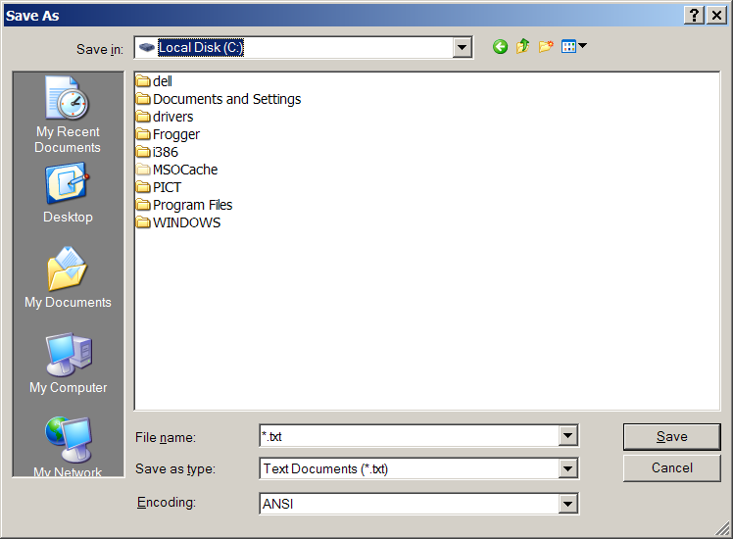
Example: EQ class partitioning
Test filename component of COMDLG32.DLL

Slide 10
Example: EQ data set
Using ONLY the ASCII character set
 | 0 | 1 | 2 | 3 | 4 | 5 | 6 | 7 | 8 | 9 | A | B | C | D | E | F
0 | NUL | STX | SOT | ETX | EOT | ENA | ACK | BEL | BS | HT | LF | VT | FF | CR | SO | SI
1 | DLE | DC1 | DC2 | DC3 | DC4 | NAK | SYN | ETB | CAN | EM | SUB | ESC | FS | GS | RS | US
2 | SP 0032 | ! 0033 | “ 0034 | # 0035 | $ 0036 | % 0037 | & 0038 | ‘ 0039 | ( 0040 | ) 0041 | * 0042 | + 0043 | , 0044 | - 0045 | . 0046 | / 0047
3 | 0 0048 | 1 0049 | 2 0050 | 3 0051 | 4 0052 | 5 0053 | 6 0054 | 7 0055 | 8 0056 | 9 0057 | : 0058 | ; 0059 | < 0060 | = 0061 | > 0062 | ? 0063
4 | @ 0064 | A 0065 | B 0066 | C 0067 | D 0068 | E 0069 | F 0070 | G 0071 | H 0072 | I 0073 | J 0074 | K 0075 | L 0076 | M 0077 | N 0078 | O 0079
5 | P 0080 | Q 0081 | R 0082 | S 0083 | T 0084 | U 0085 | V 0086 | W 0087 | X 0088 | Y 0089 | Z 0090 | [ 0091 | \ 0092 | ] 0093 | ^ 0094 | _ 0095
6 | ` 0096 | a 0097 | b 0098 | c 0099 | d 0100 | e 0101 | F 0102 | g 0103 | h 0104 | i 0105 | j 0106 | k 0107 | l 0108 | m 0109 | n 0110 | o 0111
7 | p 0112 | q 0113 | r 0114 | s 0115 | t 0116 | u 0117 | V 0118 | w 0119 | x 0120 | y 0121 | z 0122 | { 0123 | | 0124 | } 0125 | ~ 0126 | DEL 0127

Slide 11
Defining EQ subsets
Input Condition | Valid Class Subsets | Invalid Class Subsets
Filename | V1 – escape sequence literal strings (STX, SOT, ETX, EOT, ENQ, ACK, BEL, BS, HT, LF, VT, FF, CR, SO, SI, DLE, DC1, DC2, DC3, DC4, NAK, SYN, ETB, CAN, EM, SUB, ESC, FS, GS, RS, US, DEL) V2 – space character (0x20) (but not as only, first, or last character in the file name) V3 – period character (0x2E) (but not as only character in the file name) V4 – ASCII characters punctuation (0x21, 0x23 – 0x29, 0x2B – 0x2D, 0x3B, 0x3D, 0x40, 0x5B, 0x5D, 0x60, 0x7B, 0x7D, 0x7E), numbers (0x30 – 0x39) alpha (0x41 – 0x5A, 0x61 – 0x7A) V5 – Component length 0<>256 V6 – a valid string with a reserved character 0x22 as the first and last character V7 – <3 & >3 character extensions | I1 – esc. sequence literal string NUL I2 – reserved words (LPT1 – LPT4, COM1 – COM4, CON, PRN, etc) I3 – reserved words (LPT5 – LPT9, COM5 – COM9) I4 – reserved characters (0x2F, 0x3A, 0x3C, 0x3E, 0x7C) (/ : < > | ) (alone or as part of a string) I5 – reserved character 0x22 as the only character or > 2 characters, or as part of a valid string I6 – a string composed of >1 reserved characters 0x5C I7 – a string containing only 2 reserved characters 0x22 I8 – reserved character 0x5C as the only character I9 – period character (0x2E) as only character(s) I10 – space character (0x20) as only character(s) I11 – space character (0x20) as first character in a string I12 – space character (0x20) as last character in a string I13 – reserved characters (* ?) (0x2A, 0x3F) I14 – reserved characters 0x2A, 0x3F embedded in string I15 – string contains at least one reserved character 0x5C but not in the first position I16 – string > 256 characters I17 – character case sensitivity I18 – a reserved device name with valid extension I19 – empty string

Slide 12

Example: Defining EQ tests
Test# | Subset combinations
1 | V1
2 | V2 ∪ V3 ∪ V4 ∪ V5
3 | V2 ∪ V3 ∪ V4 ∪ V5 ∪ V6
4 | V2 ∪ V3 ∪ V4 ∪ V5 ∪ V7
5 | I1
6 | I2
7 | I3
8 | I4
9 | I4 ∪ V2 ∪ V3 ∪ V4 ∪ V5
10 | I5
11 | I5 ∪ V2 ∪ V3 ∪ V4 ∪ V5
12 | I6
13 | I7
14 | I8
Test# | Subset combinations
15 | I9
16 | I10
17 | I11 ∪ V2 ∪ V3 ∪ V4 ∪ V5
18 | I12 ∪ V2 ∪ V3 ∪ V4 ∪ V5
19 | I13
20 | I13 ∪ V2 ∪ V3 ∪ V4 ∪ V5
21 | I15 ∪ V2 ∪ V3 ∪ V4 ∪ V5
22 | I16 ∪ V2 ∪ V3 ∪ V4 ∪ V5
23 | I17 ∪ V2 ∪ V3 ∪ V4 ∪ V5
24 | I18 ∪ I1
25 | I18 ∪ I2
26 | I18 ∪ I3
27 | I19
EQ Demo 1
EQ Demo 2

Slide 13
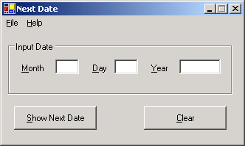
Practice: EQ class partitioning
A program takes three integer inputs for a given month, day, and year and returns the next date on the Gregorian calendar in month/day/year format.

Slide 14

Key points – EQ partitioning
Effective in reducing number of test cases
Helps reduce redundant tests
Requires in-depth domain and system knowledge to be most effective
  Functionality, system interaction, data, implementation, etc.
  Special case situations often missed bugs!
  Edge or corner cases often overlooked
  Combinations of subsets overlooked

Slide 15
Boundary value analysis (BVA)
Validates input and/or output conditions
  Extreme values of the ranges of physical variables
  Values at, and immediately above and below the edges of equivalence classes
Boundary values determined by:
  Data types
  Artificially constrained data types
  Special or unique equivalence class subsets
Primary testing focus
  Artificially constrained types
  Incorrect relational operators

Slide 16
Basic BVA
Boundary analysis for independent variables
3 times the number of boundary conditions
Test | X | Y
1 | Min -1 | Nom
2 | Min | Nom
3 | Min+1 | Nom
4 | Max-1 | Nom
5 | Max | Nom
6 | Max+1 | Nom
7 | Nom | Min-1
8 | Nom | Min
9 | Nom | Min+1
10 | Nom | Max-1
11 | Nom | Max
12 | Nom | Max+1
max
Y
min
min
X
max

Slide 17
Example: BVA
Filename component boundaries
  Minimum valid base filename length = 1
  Maximum valid base filename length = 251
  Maximum valid filename length = 255
3 boundary conditions = 3 * 3 = 9 tests
 | Minimum filename | Maximum base filename | Maximum filename
Boundary –1 | fn length = 0 | fn length = 250 | fn length = 254
Boundary condition | fn length = 1 | fn length = 251 | fn length = 255
Boundary +1 | fn length = 2 | fn length = 252 | fn length = 256
BVA Demo 1
BVA Demo 2

Slide 18
Practice: Boundary value analysis
A program takes three integer inputs for a given month, day, and year and returns the next date on the Gregorian calendar in month/day/year format.

Slide 19
Key points – Boundary testing
Errors are likely to occur near the extreme ranges of a values
  Especially if default types are artificially constrained
Specific, targeted tests are easy to define
  once boundary conditions are understood
The code specifies the boundaries

Slide 20
Combinatorial analysis
Evaluates various combinations of variables of dependent parameters
Combinations determined by
  Dependency between parameters
  Number of variables per parameter
  Equivalence class subsets of variables
Primary testing focus
  Interactions of parameter variables in different combinations

Slide 21
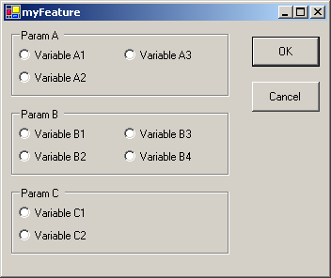
Dependent parameter testing
Traditional approaches
  Test each value once
  Choose combinations by hand
A₁ B₁ C₁ | A₁ B₁ C₂ | A₂ B₁ C₁ | A₂ B₁ C₂ | A₃ B₁ C₁ | A₃ B₁ C₂
A₁ B₂ C₁ | A₁ B₂ C₂ | A₂ B₂ C₁ | A₂ B₂ C₂ | A₃ B₂ C₁ | A₃ B₂ C₂
A₁ B₃ C₁ | A₁ B₃ C₂ | A₂ B₃ C₁ | A₂ B₃ C₂ | A₃ B₃ C₁ | A₃ B₃ C₂
A₁ B₄ C₁ | A₁ B₄ C₂ | A₂ B₄ C₁ | A₂ B₄ C₂ | A₃ B₄ C₁ | A₃ B₄ C₂
Total combinations is the Cartesian product of the variable count for each parameter

Slide 22
Case studies
Attrib.exe – path + 6 optional argv.
Findstr.exe – string + 19 optional argv.
Total # of block = 483 | “Minimum” tests | Exploratory tests | Pair-wise tests
Number of test cases | 9 | 972 | 13
Blocks covered | 358 | 370 | 370
Code coverage | 74% | 77% | 77%
Functions fully covered | 11 | 11 | 11
Functions partially covered | 9 | 9 | 9
Functions not covered | 15 | 15 | 15
Total number blocks = 1317 | Defined tests | N=2 coverage | N=3 coverage | N=4 coverage
Number of test cases | 236 | 136 | 800 | 3533
Blocks covered | 960 | 979 | 994 | 1006
Code coverage | 73% | 74% | 75% | 76%
Functions fully covered | 25 | 25 | 27 | 27
Functions partially covered | 33 | 33 | 32 | 32
Functions not covered | 11 | 11 | 10 | 10

Slide 23


Pair-wise testing process
Feature
Decomposition
Create
model file
Tool
Input
Re-validate
Output
Validate
Output
Modify model
Test

Slide 24
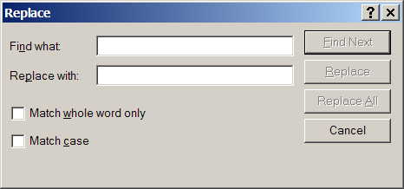
Feature decomposition
Textbox parameters
Checkbox parameters
Button controls
Wordpad contents
Return

Slide 25
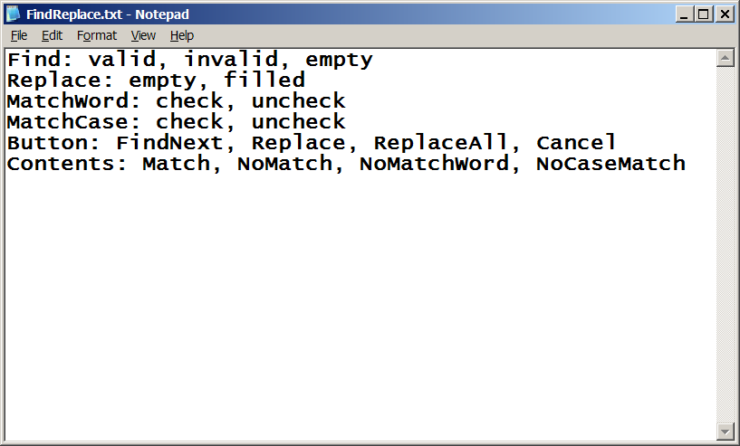
PICT model file
Parameter separated by colon, variables separated by commas
Return

Slide 26
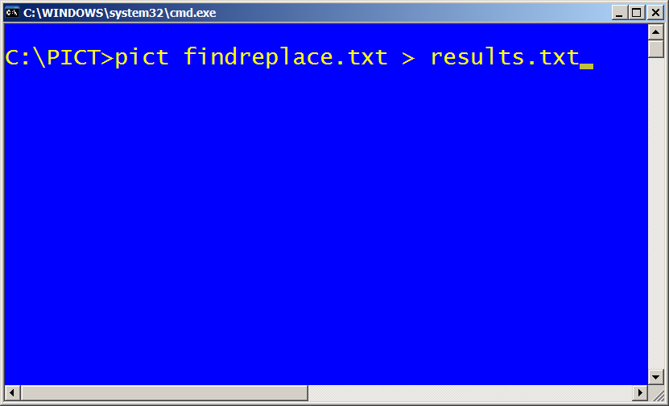

Basic PICT usage
PICT is a command line application
Don’t forget to pipe the output
to a file. A text file is sufficient
because the output is a tab
delimited file.
Return

Slide 27
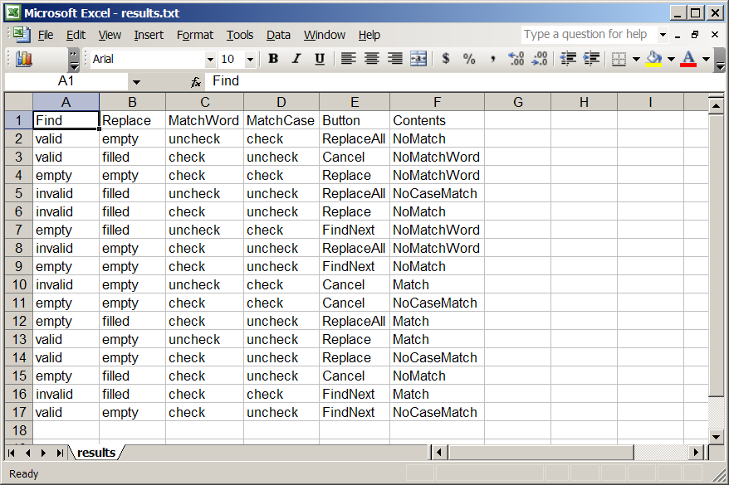
Validate tool output
Tab delimited output file opened with Excel
Return

Slide 28
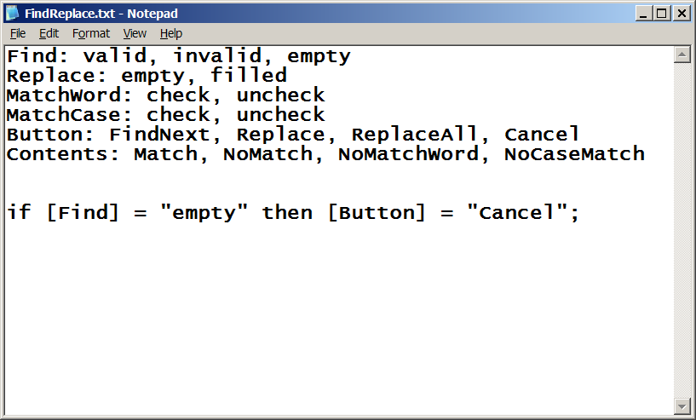
Modify the model file
Add constraints
Return

Slide 29
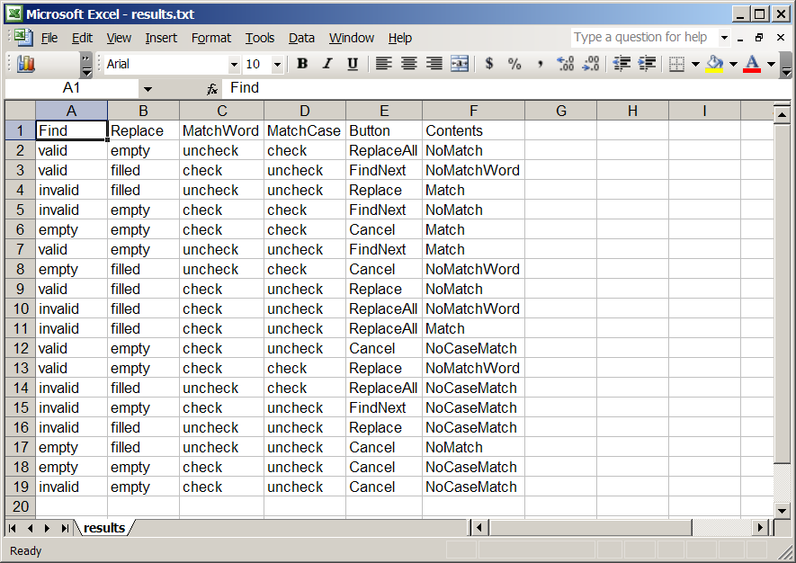
Revalidate tool output
Return

Slide 30
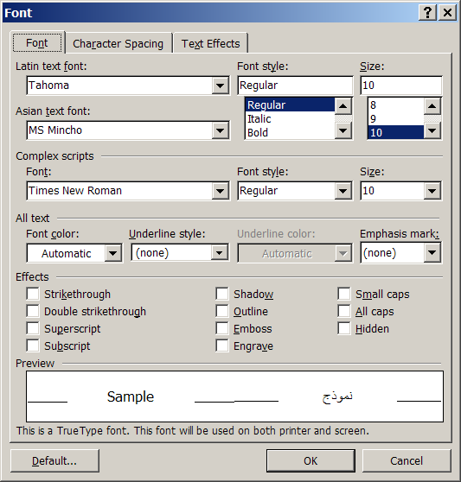
Practice: Combinatorial analysis
Parameters
  Latin text font
  Font style
  Size
  Font color
  Underline style
  Effects

Slide 31
Key points – Pair-wise testing
Low cost implementation (many free tools)
Outputs easy to integrate into automation
Fewer tests, but same level of coverage
Mathematical algorithm vs. best guess
Requires expert domain knowledge
  The output of the tool depends on the input
The tool does not replace the tester
  Never use a tool blindly
  The outcome must be reviewed

Slide 32

Review
Review your initial tests for the triangle program.
How well do you think you effectively assessed ‘quality’ in regard to the functional spec with your initial set of tests?
Based on the functional techniques just discussed, what tests would you add, change, or delete?

Slide 33
Summary
The EQ class partitioning technique can effectively reduce redundant tests and increase breadth
The BVA technique provides a solid foundation
of targeted tests with a high probability of detecting errors
Combinatorial analysis provides a scientific base for managing complex interactions
Functional techniques require a great deal of domain and “system” knowledge to be most effective

Slide 34
Structural techniques
White box test design techniques
Focus on control flow
Used specifically to increase code coverage
Techniques include:
  Statement, block coverage
  Decision coverage
  Condition coverage
  Basis path coverage

Slide 35


Black box test effectiveness
Software
Project
Testing
Effort
35% – 65%
- B. Beizer

Slide 36

Structural testing
target %
White box
approach
Coverage
n%
Black box
approach
Time

Slide 37
Basic coverage
Function – percentage of functions called during execution
Statement – amount of statements executed
Block – contiguous blocks of statements executed
Most effective for:
  Simple functions, methods, or event handler

Slide 38
Function, statement, block coverage
Example 1
private void ExitMenuClick(object sender, EventArgs e)
{
Application.Exit();
}
Example 2
private bool IsInvalidTriangle(UInt16 a, UInt16 b, UInt16 c)
{
if ((a + b <= c) || (b + c <= a) || (a + c <= b))
{
return true;
}
return false;
}

Slide 39

Example: Basic control flow testing
A1 public static int CharIndex(string str, char c)
{
int i = 0;
int retVal = 0;
char[] s = str.ToCharArray();
A2 while ((i < s.Length) && (s[i] != c))
{
i++;
}
A3 if (i < s.Length)
{
retVal = i;
}
return retVal;
A4 }
A1
A2
A3
Block coverage demo
A4

Slide 40
Decision testing
Evaluates the true and the false outcomes of simple Boolean expressions
Most effective for:
  Simple conditional statements
  Switch / case statements
  Exception handling
  Simple loops

Slide 41
Example: Switch statement
A1
... // other stuff
case WM_KEYDOWN:
A1 switch(wParam)
{
A2 case VK_UP:
MoveUp(hWnd);
break;
A3 case VK_DOWN:
MoveDown(hWnd);
break;
A4 case VK_LEFT:
MoveLeft(hWnd);
break;
A5 case VK_RIGHT:
MoveRight(hWnd);
break;
A6 }
... // other stuff
A2
A3
A4
A5
A6

Slide 42
Loops
A1
A1 private void ButtonClick (object sender, EventArgs e)
{
uint[] side = new uint[3] {0, 0, 0};
string[] input = new string[3] {a.Text, b.Text, c.Text}
A2 for (int i = 0; i < side.Length; i++)
{
A3 if (!ConvertInput(input[i], ref side[i]))
{
return;
}
}
A4 ... // Do some other stuff
A5 }
A2
A3
A4
A5

Slide 43
Example: Exception handling
A1
A1 public bool ConvertInput(string inVal, ref UInt16)
{
try
{
A2 sideVal = Convert.ToUInt16(inVal);
A3 if (sideVal < 1)
{
this.lblResult.Text = “Must be > 0.”
return false;
}
}
A4 catch(OverflowException, e)
{
this.lblResult.Text = e.Message;
return false;
}
A5 catch(FormatException, e)
{
this.lblResult.Text = e.Message;
return false;
}
return true;
A6 }
A2
A3
A4
A5
A6

Slide 44
Practice: Decision coverage
Assume inputs for a, b, and c args are valid
Create control flow diagram, define tests
A1 private void GetTriangleType(UInt16 a, UInt16 b, UInt16 c)
{
A2 if ((a == b) && (b == c))
{
this.lblResult.Text = Resources.strEquilateral;
}
A3 else if ((a != b) && (b != c) && (a != c))
{
this.lblResult.Text = Resources.strScalene;
}
else
{
this.lblResult.Text = Resources.strIsosceles;
}
A4 }

Slide 45
Condition (Arc) testing
Sub-expressions evaluated to both TRUE and FALSE outcomes
Better sensitivity to control flow as compared to block or decision coverage
Most effective for:
  Compound conditional statements

Slide 46
Example: Condition testing
Assumes short-circuiting
Does not include data-flow
A1
A1 private bool IsInvalidTriangle(UInt16 a, UInt16 b, UInt16 c)
{
A2 A3 A4
if ((a + b <= c) || (b + c <= a) || (a + c <= b))
{
return true;
}
return false;
A5 }
A2
A3
A4
A5

Slide 47
Practice: Condition testing
A1 private void GetTriangleType(UInt16 a, UInt16 b, UInt16 c)
{
A2 if ((a == b) && (b == c))
{
this.lblResult.Text = Resources.strEquilateral;
}
A3 else if ((a != b) && (b != c) && (a != c))
{
this.lblResult.Text = Resources.strScalene;
}
else
{
this.lblResult.Text = Resources.strIsosceles;
}
A4 }

Slide 48
Basis path testing
Testing all possible paths is impossible
Based on McCabe’s cyclomatic complexity metric
Number of basis paths = v(G) = (E – N) + 2
  or…number of conditional expressions + 1
Basis paths are ‘independent’ path subset
Any other paths are a super-set of the basis paths

Slide 49
Baseline path method
Find shortest path from entry to exit
Return to algorithm entry point
Change next conditional expression or sub-expression to alternate outcome
Follow shortest path to exit point
Repeat until all basis paths defined
It is possible to have different basis path sets!

Slide 50
Example: Basis path testing
A1 public static int CharIndex(string str, char c)
{
int i = 0;
int retVal = 0;
char[] s = str.ToCharArray();
A2 A3
while ((i < s.Length) && (s[i] != c))
{
i++;
}
A4 if (i < s.Length)
{
retVal = i;
}
return retVal;
A5 }
A1
A2
A3
A4
A5

Slide 51
Practice
A1 if (strArray[index] == 'A')
{
A2 while (index < strArray.Length)
{
A3 if (strArray[index] == 'B')
{
j = j + 1;
k = 0;
}
A4 if (strArray[index] == 'C')
{
i = i + j;
k = k + 1;
j = 0;
}
i = i + j;
A5 if (index < strArray.Length)
{
j = 0;
}
index++;
}
Console.WriteLine("'C‘ count is: {0}”, i);
}
else
{
Console.WriteLine(“Invalid string");
A6 }

Slide 52
Discussion – structural testing
Review your tests for the triangle program again against the code.
How well did your tests effectively assess the stated requirements?
Based on the white box techniques just discussed, what tests would you add, change, or delete

Slide 53
Summary
Structural testing techniques supplement functional tests to improve code coverage
We must not rely solely on structural tests
  Coverage metrics are misleading if used improperly
The minimum goal of structural testing is to ensure we exercise all (or nearly all) executable statements, and both the TRUE and FALSE outcomes of Boolean expressions at least once
Structural testing is an organizational investment to effectively reduce risk

Slide 54
Recommended reading
The Art of Software Testing 1st Ed., Glenford Myers
Black-Box Testing : Techniques for Functional Testing of Software and Systems, Boris Beizer
Software Testing Techniques 2nd Ed., Boris Beizer
Testing Object-Oriented Systems: Models, Patterns, and Tools, Robert Binder
Pragmatic Unit Testing in C# with NUnit, Andy Hunt and Dave Thomas

